Slide 1
X-O Game
By Muhammad Ansari

Slide 2
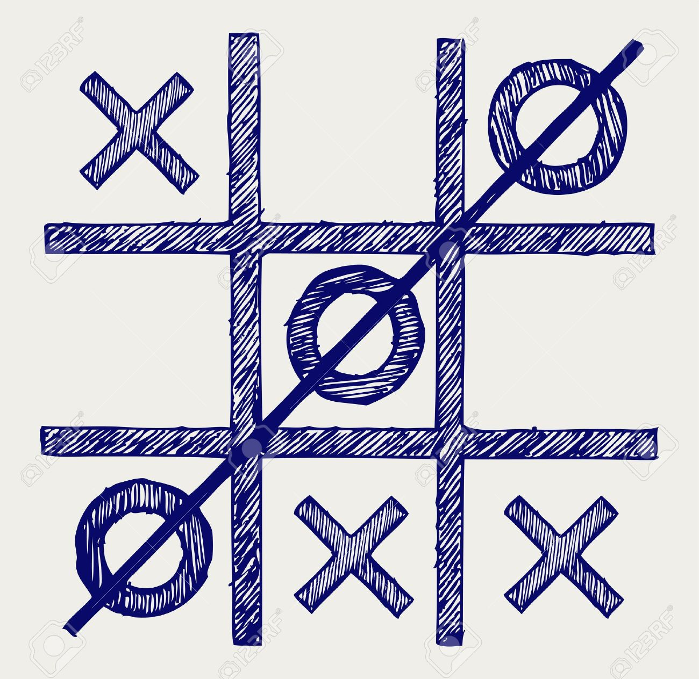
Objectives
Two-player game. Players take turns inputting values.
Players must input X and O into the nine positions on the board
Winner is determined when a player manages to create three X’s or O’s in a line
Reset button allows players to play it multiple times

Slide 3
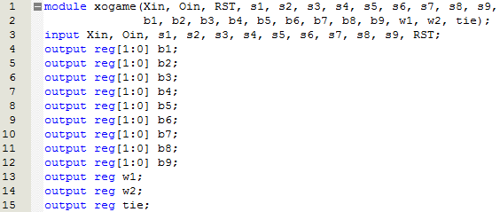
Implementation – Inputs/Outputs
Inputs Xin and Oin determine whether the player will input “X” or “O”
Nine inputs (s1 – s9) are used to display the “X” or “O” on the board through the nine outputs (b1 – b9)
RST input restarts the game
Outputs w1, w2 and tie display which player won the game or if the game was a tie

Slide 4
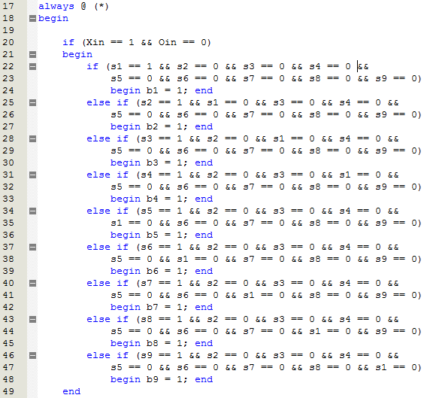
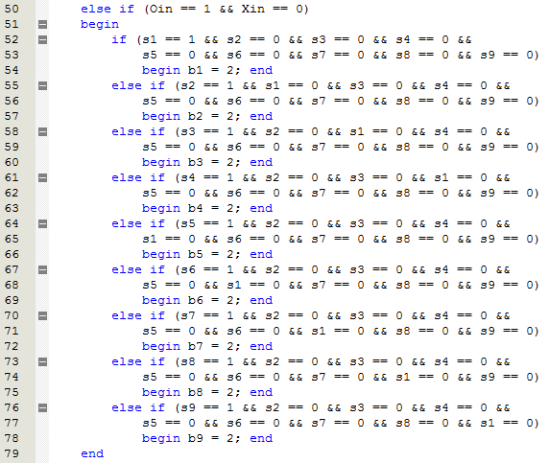
Implementation - Inputting
Player first inputs either “X” or “O” through a switch
Player then inputs the selected value into one of the boxes on the game board using one of the nine corresponding switches

Slide 5
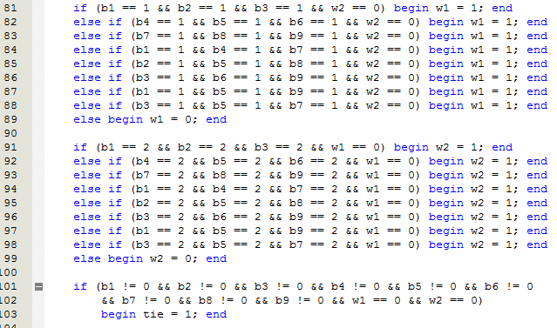
Implementation - Outputting
After every input, the program checks for a win condition
If one of the eight win conditions for either “X” or “O” are fulfilled, the output to determine the winner will turn on
If the board is completely filled, and no win conditions are fulfilled, the “tie” output turns on

Slide 6
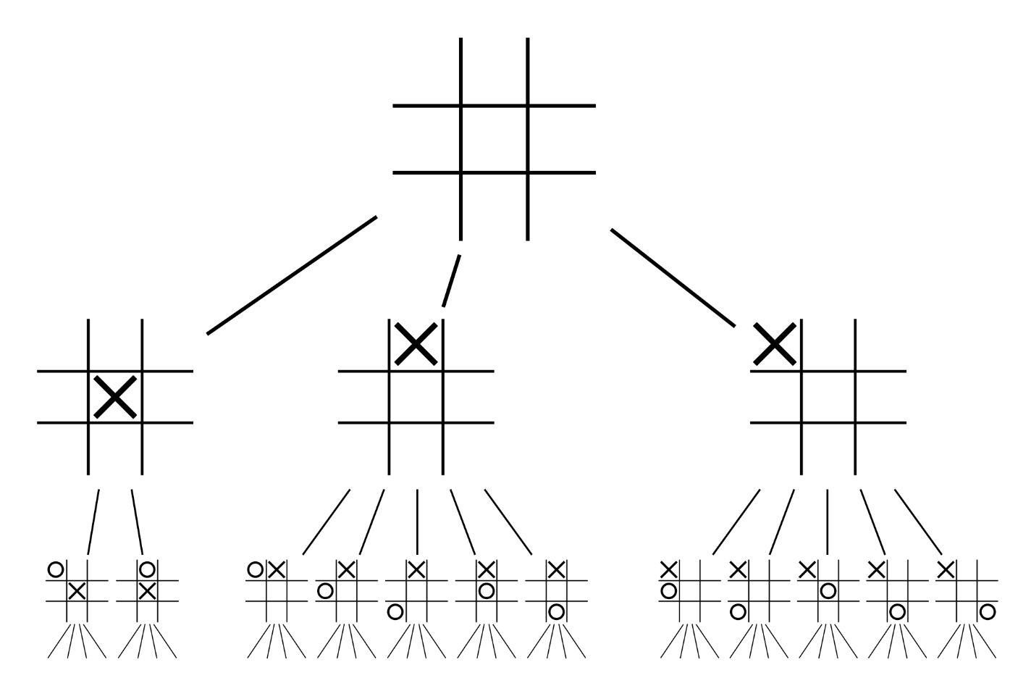
Problems we ran into…
Implementing a system which forces players to enter “X” and “O” in alternating order
Disallowing users to change inputs after they have already entered “X” or “O” in a block

Slide 7
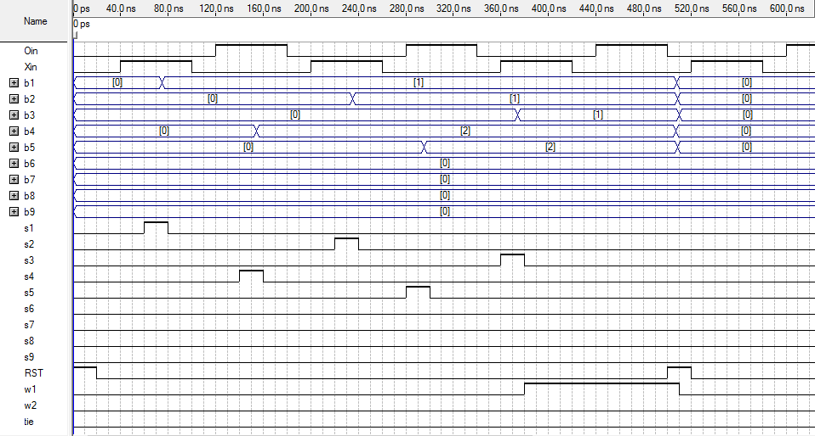
Results

